Slide 1
FYP5: Object Detection, Tracking and Suspicious Activity Recognition for Maritime Surveillance using Thermal Vision

Slide 2
Weekly Tasks
TRN network training completion on Thumos-14 and test its accuracy
Hopefully to train/test TRNs with different feature extractors and optical flow algos.
Try to simulate the 3 DOF Stewart Platform wrt various servo motor configurations.

Slide 3
Training TRN
What we did
1. Using ResNet50 and BN_Inception extracted features from 20 videos
2. Using CenterNet backbone model extracted features from 116 videos
3. Trained the TRN for 10 epochs on Features from ResNet50 and BN_Inceptions
4. Running on CenterNet extracted features
Issues
Takes a lot of time on data preparation for training
With default batch sizes (32) the Colab memory runs out
With lesser batch sizes (16) training runs fine but it takes around 67 iteration to complete one epoch on 96 videos with 90000+ video chunks (total run time 1695.20s per epoch – with debugging 18 iterations)

Slide 4
Training TRN - Options
Colab
Google Cloud
Amazon Web Services
UoM GPUs
Ravana – 4GB RAM
Other GPUs?

Slide 5
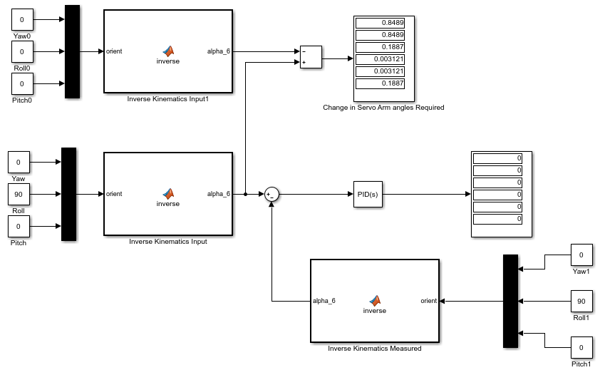
Control System

Slide 6
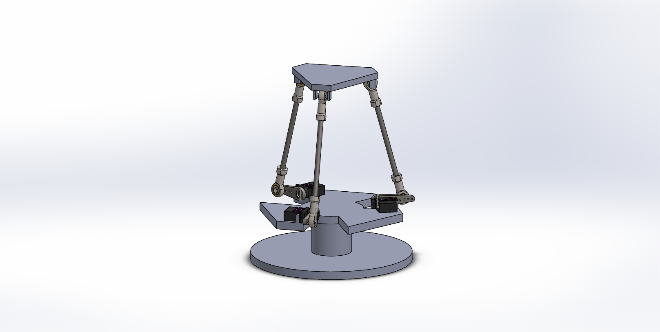

Slide 7
